Slide 1

DEPRESSION CLASSIFICATION BY ANALYSING USER ACTIVITIES BY ANJALI KERKETTA (17AT61R06) BRITI GANGOPADHYAYA (17AT61R09)
ADVANCED TECHNOLOGY DEVELOPMENT CENTRE
INDIAN INSTITUTE OF TECHNOLOGY
KHARAGPUR

Slide 2
PRODUCT DESCRIPTION
A Depression Monitoring System which will analyse the daily activities and other parameters such as location , exposure to light etc of an user and based on the data collected over a period of time will be able to predict whether the user is depressed or not.

Slide 3


DESIGN
CLOUD
Average acceleration
Activity classification and Step Counting
Variance
Activity type, MAVP duration etc
Sensor and user data
Filtering
Average Absolute difference
Combine with user input (Age, PHQ-9 score etc)
Average Resultant acceleration
Depression classification
Average time between peaks

Slide 4
TEAM RESPONSIBILITIES
Briti Gangopadhyay – Application Development, Data analysis and Activity Prediction
Anjali Kerketta – Kalman Filtering.

Slide 5
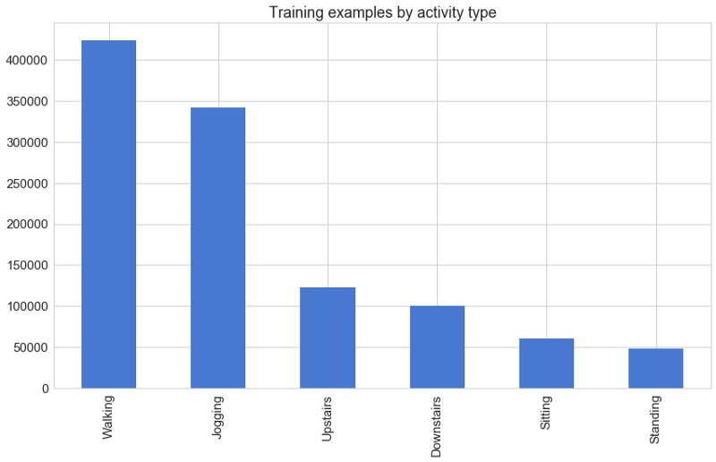
DATASET

Slide 6
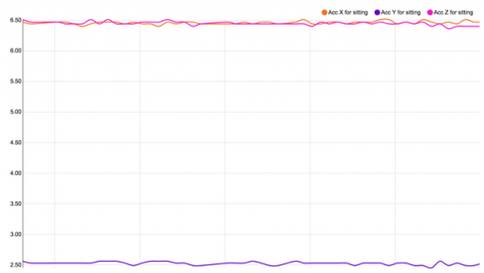
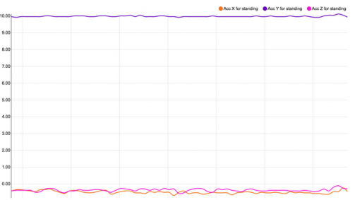
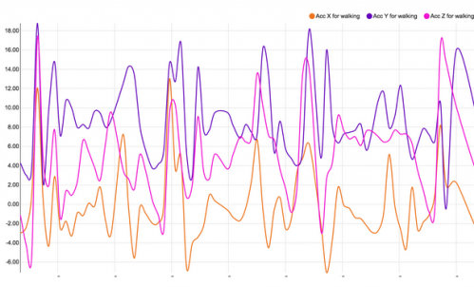
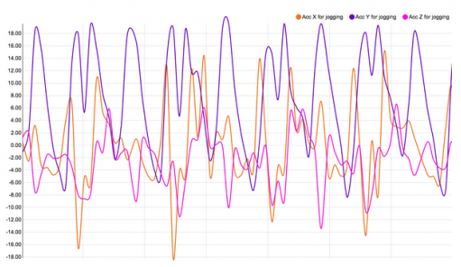
ANALYSIS
Sitting Standing
Walking Jogging

Slide 7
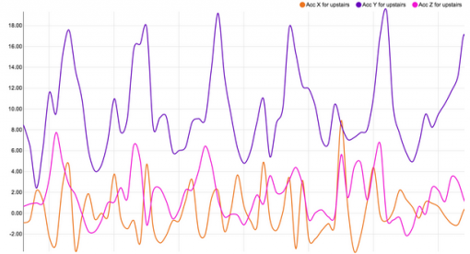
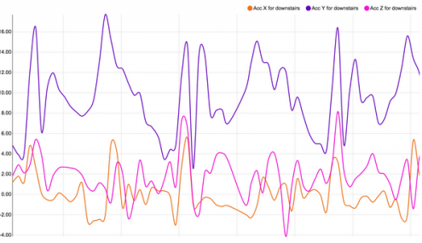
Walking upstairs
Walking downstairs

Slide 8
MODELS
MODEL | Decision Tree | Random Forest | LSTM Neural Network
Accuracy (N = 7000) | 80.6% | 80.8% | 97%

Slide 9
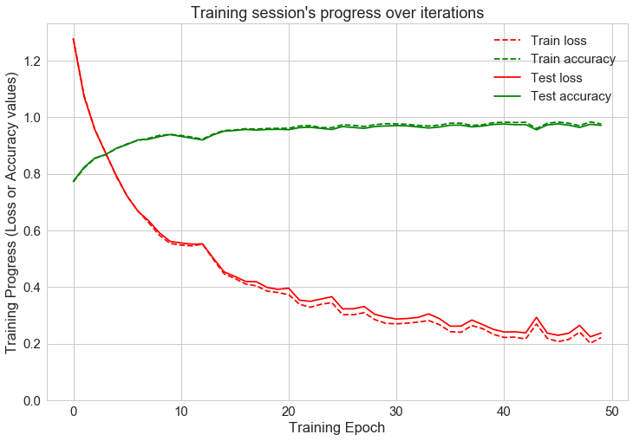
TRAINING
Learning rate = 0.025 Epoch = 50

Slide 10
ACTIVITY CLASSIFICATION CONFUSION MATRIX
Actual/Predicted | Downstairs | Jogging | Sitting | Standing | Upstairs | Walking | Precision
Downstairs | 975 | 3 | 0 | 0 | 68 | 12 | 0.93
Jogging | 27 | 3370 | 0 | 0 | 44 | 6 | 0.97
Sitting | 3 | 0 | 561 | 12 | 1 | 0 | 0.97
Standing | 7 | 0 | 1 | 427 | 1 | 1 | 0.97
Upstairs | 50 | 2 | 0 | 1 | 1128 | 26 | 0.93
Walking | 24 | 7 | 0 | 0 | 18 | 4206 | 0.98

Slide 11
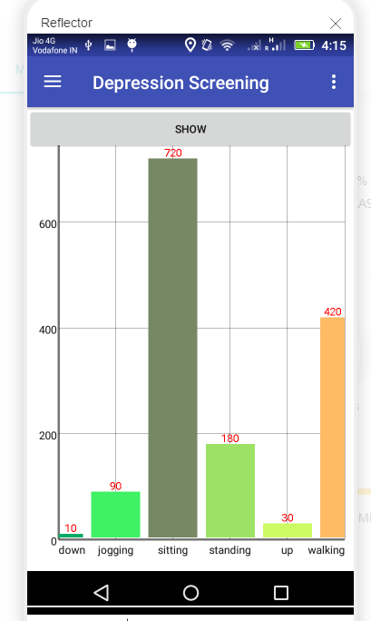
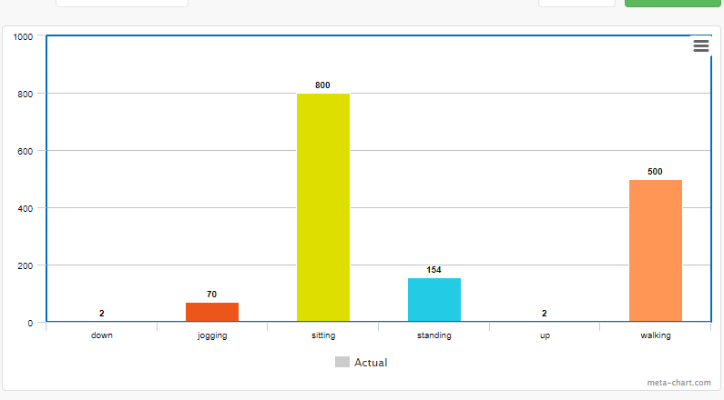
RESULTS ON STORED DATA

Slide 12
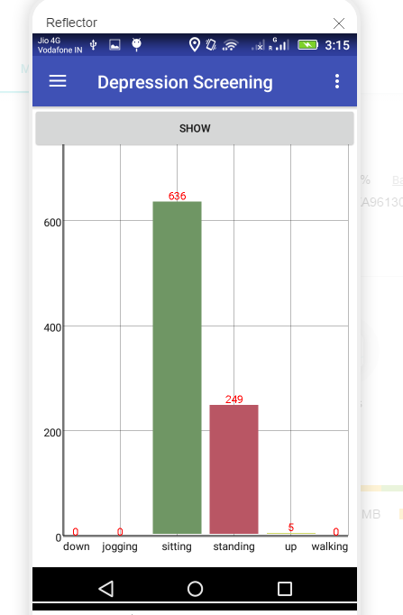
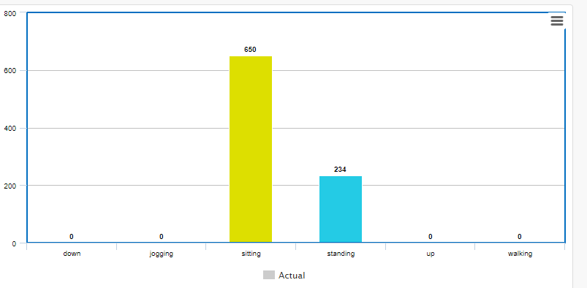
RESULTS ON STORED DATA

Slide 13
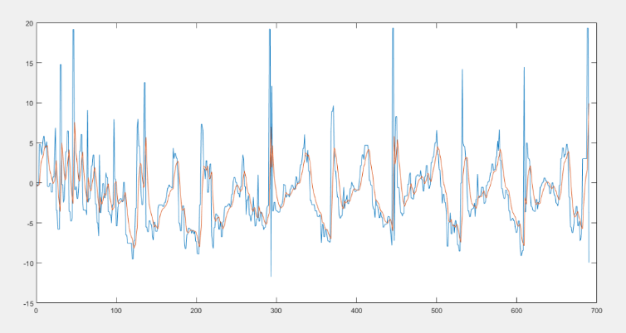
RESULTS
Matlab filtering

Slide 14
DEPRESSION CLASSIFICATION
Dataset
In total, 5,423 children participating in ALSPAC at a mean age 18 years and were asked to wear an accelerometer for a week. Data on physical activity were available for 3,357 children (62% of clinic attenders) who had worn the accelerometer for at least 10 h per day for at least 3 days. The majority of these (n = 3,298) had completed the PHQ-9 in the clinic. Data on potential confounders (listed in items 1–5 above) were available for 2,951 adolescents.

Slide 15
FEATURES
User Input
1)Depression Questioner Score (PHQ-9)
Depression Severity: 0-4 none, 5-9 mild, 10-14 moderate, 15-19 moderately severe, 20-27 severe.
3) Gender
4) Age
3) Markers of socioeconomic position (SEP) - (0 1 2)
4) Obesity
5) Substance use
Calculated by the application
6) Activity (Sedentary and MVPA)

Slide 16
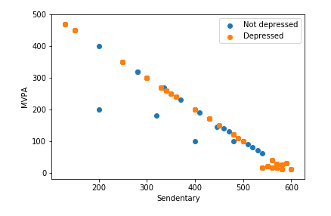
DATA DISTRIBUTION

Slide 17
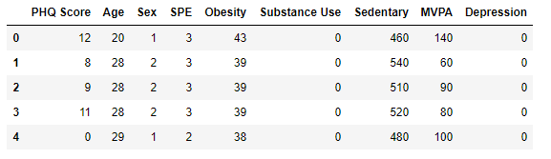

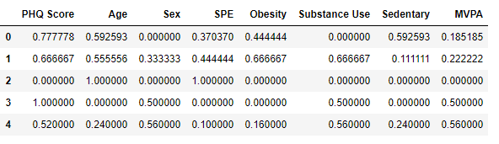
DATA PREPROCESSING

Slide 18
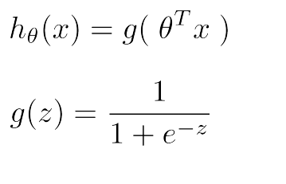
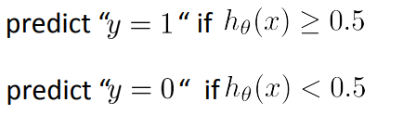

LOGISTIC REGRESSION
Logistic regression is a statistical method for analyzing a dataset in which there are one or more independent variables that determine an outcome.
h(x) = $θ0X0+θ1X1+θ2X2+θ3X3+θ4X4+ θ5X5+θ6X6+θ7X7+$B

Slide 19

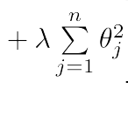
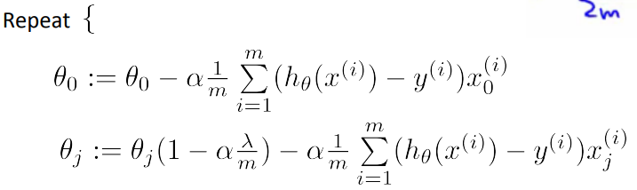
GRADIENT DESCENT
Alpha = 0.03 Lambda = 0.01 batch_size = 30

Slide 20
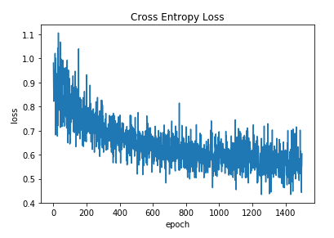
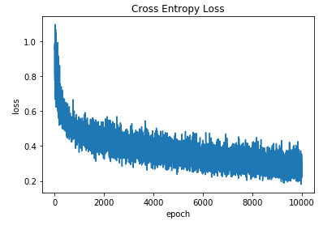
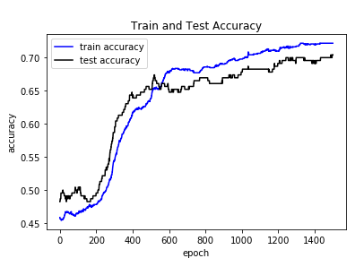
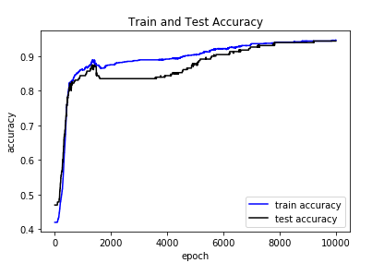
RESULTS
1500 Iterations
10000 Iterations

Slide 21
THANK YOU

